Slide 1

Bay Area Real Estate Market Analysis --Buyer’s Guide Book
Chenwei Cao
March 13 2020

Slide 2
Introduction
Data Tour
Market Insights
Summary

Slide 3


Slide 4

1.
Introduction
Let’s start with the first set of slides

Slide 6
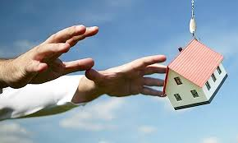
Has the Bay Area housing market finally priced itself out of reach for, well, everyone?
According to a new survey of more than 100 economists and real estate experts, the answer is yes.
web scraping can extract and make available vast amounts of data which can be used for analysis.
With the help of web scraping we extracting the data from MLS Listing and Zillow website,
Website: https://www.mlslistings.com/ and https://www.zillow.com/

Slide 7
Introduction/Conclusion
What questions we are trying to explore ?
What kind of of data we have in the dataset?

Slide 8
Data Description? Statistic ? Mean Median Max and Min ?

Slide 9
Our process is easy
last
second
first

Slide 10

Data Tour

Slide 11
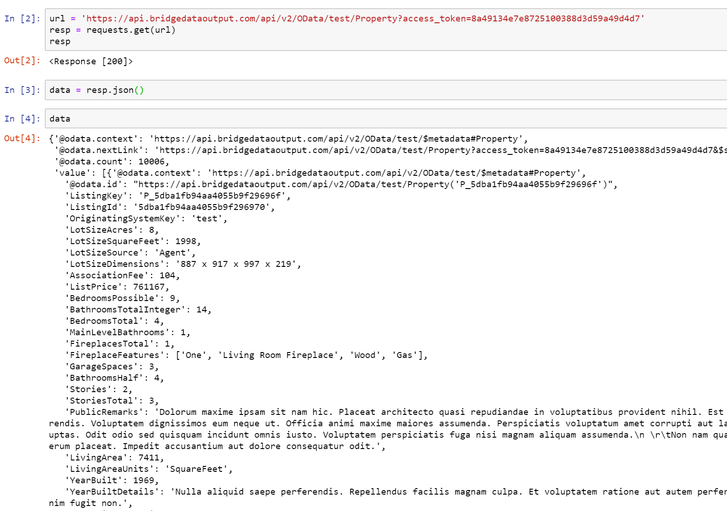
Web Scraping:
Accessing Zillow’s Bridge API.
Ultimately did not end up being used because of a number of limitations:
Querying limitations
Lack of information in nested Json()

Slide 12
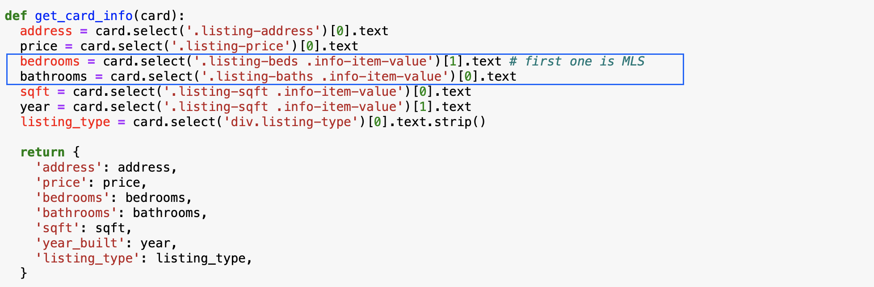
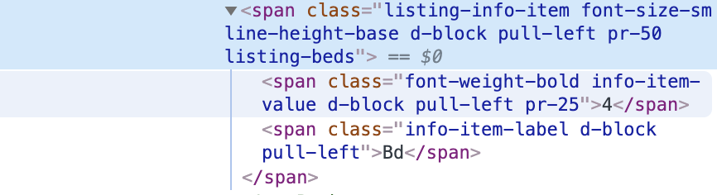
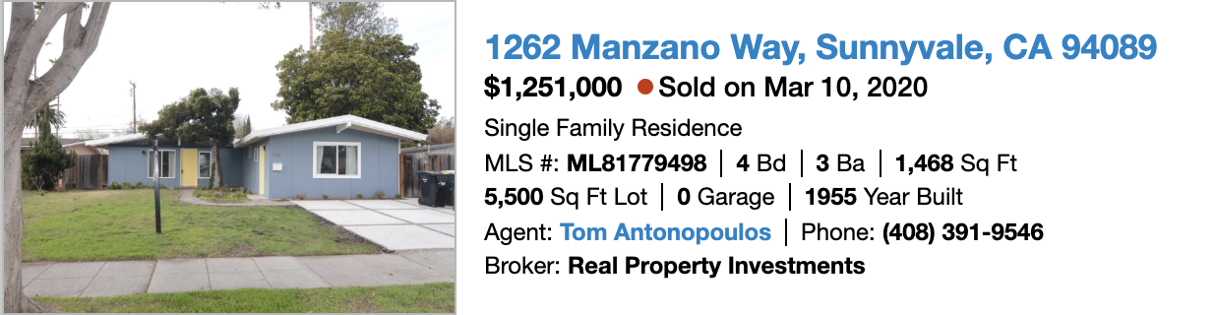
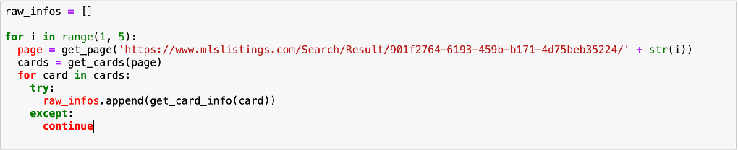
Web Scraping
BeautifulSoup
CSS Selectors

Slide 13
Data Cleaning Techniques
Data Cleaning Process
Define, Code, Test
Data Issues
Data Quanlity
issues with content. Low quality data is also known as dirty data.
Eg, Missing Value, Duplicates,Values are far outside outside a realistic range,
Erroneous Date Type, Wrong measurement units, Lowercase mixed with Uppercase
Data Tidiness
issues with structure that prevent easy analysis, known as messy data
Eg. Naming Convention, two variables in one column,
Assessment
Visual Assessment: eg. excel, text editor.
Programmatic Assessment: eg. df.head(), df.info(), df.describe(), isnull(), duplicated(),

Slide 14
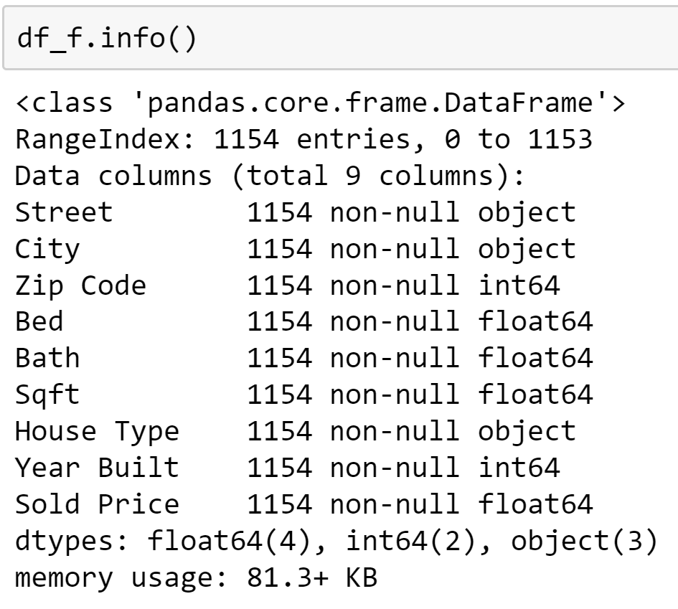
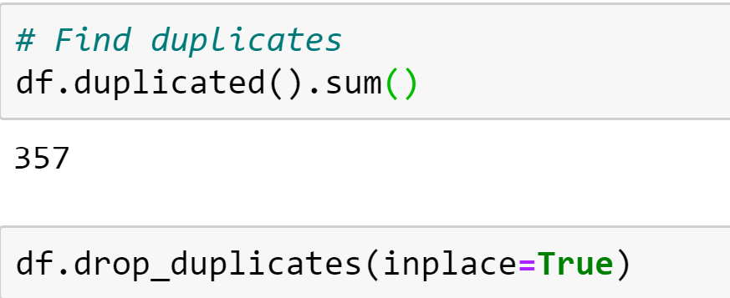
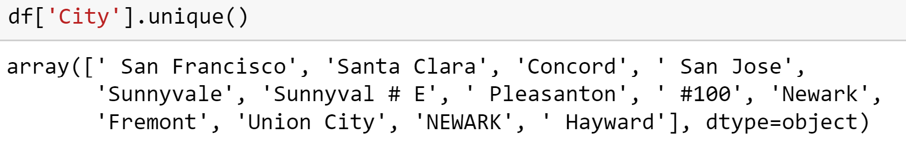
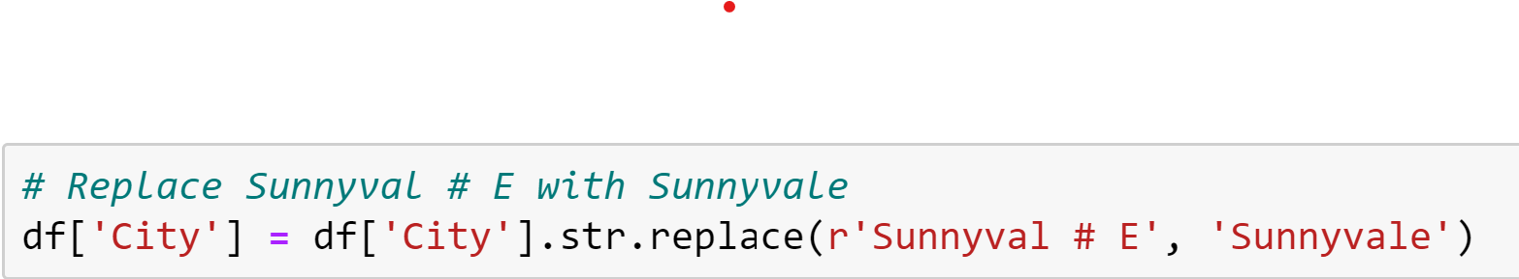
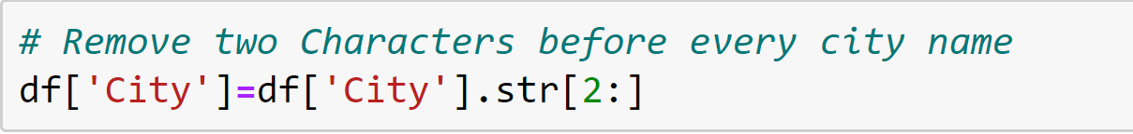
Data Cleaning Techniques
Check & Change Data Type Check & Drop Duplicates
Check & Fix Dirty Data

Slide 15
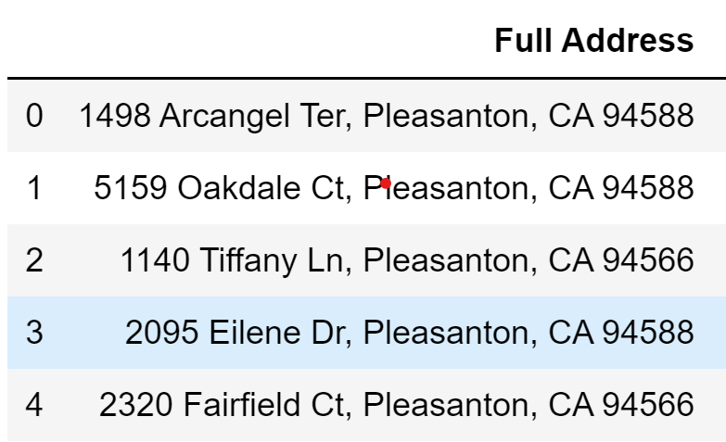
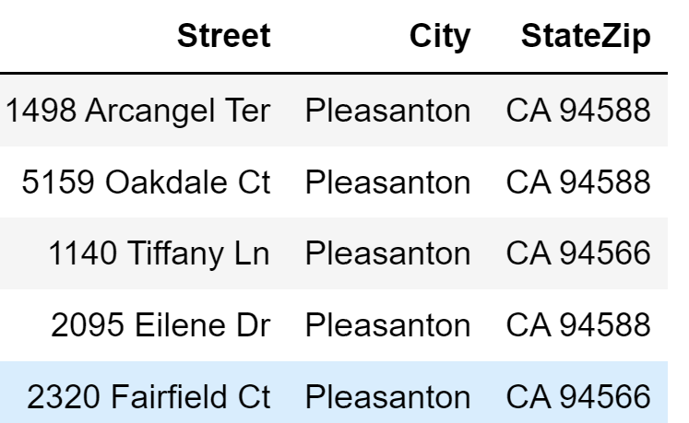
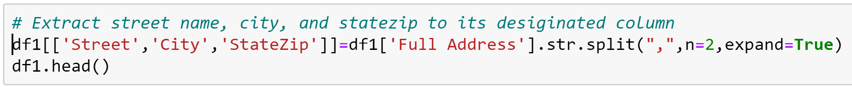
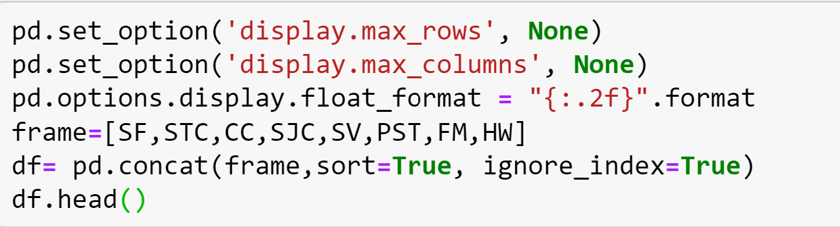
Data Cleaning Techniques
Extract Value to Columns Outcome
Dataset Concatenation & Display Setting

Slide 16
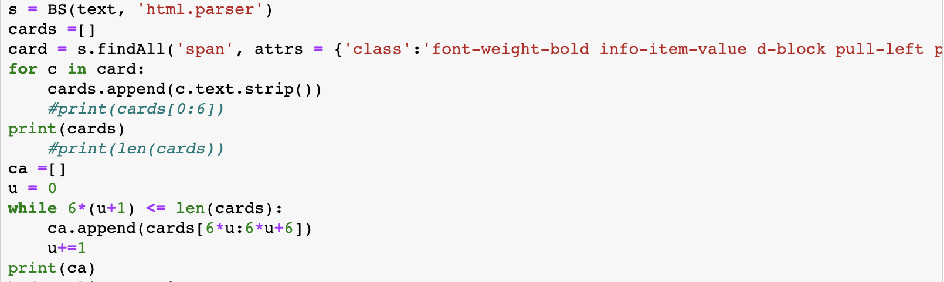
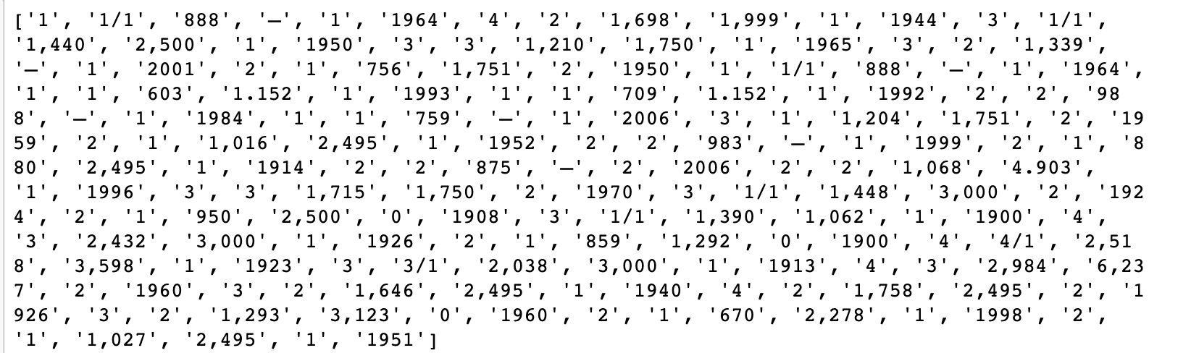
Data Cleaning Techniques
Have you ever had this problem?
The value inside the output list include “Bed room number”, “Bath room number”, “Squart Foot”, “Loot size”, “Garage”, and “Year Build”
How to clean data from this multiple data list?

Slide 17
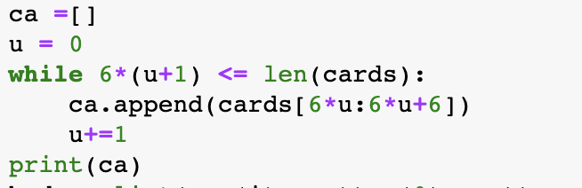
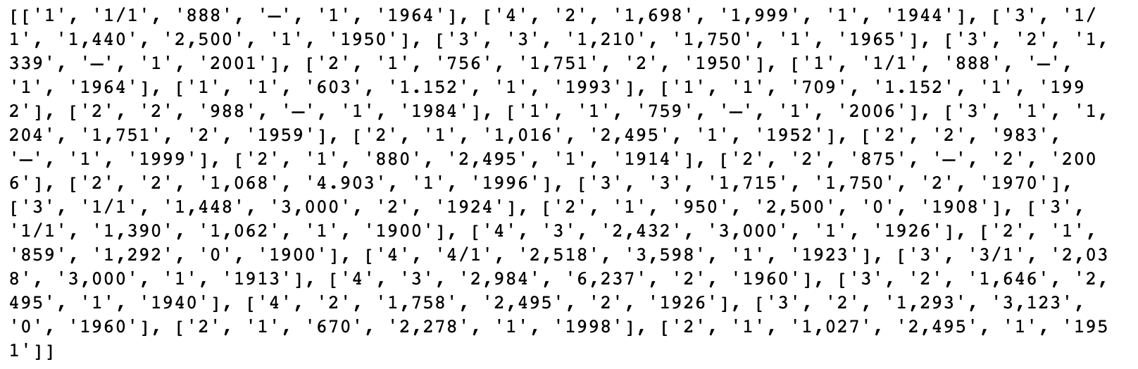
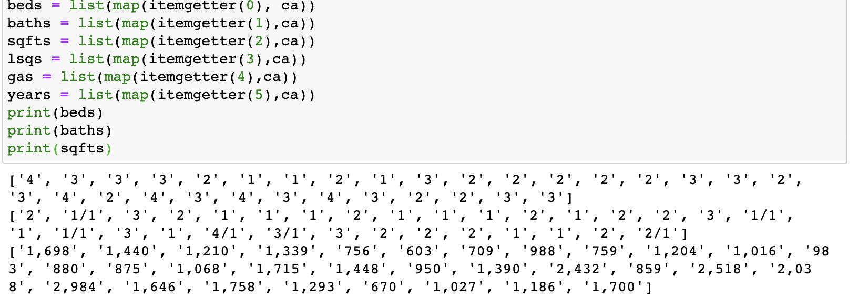
Data Cleaning Techniques
Here is what I did...
In list ca, I just divided the multiple data list to multiple small lists which just contain 6 data in each small list. Such as, we have [“Beds”, “Baths”, “SqFt”, “Loot size”, “Garage”, “Year Build”]as a value for ca.
We can use map method and itemgetter to clean data from ca list.

Slide 18
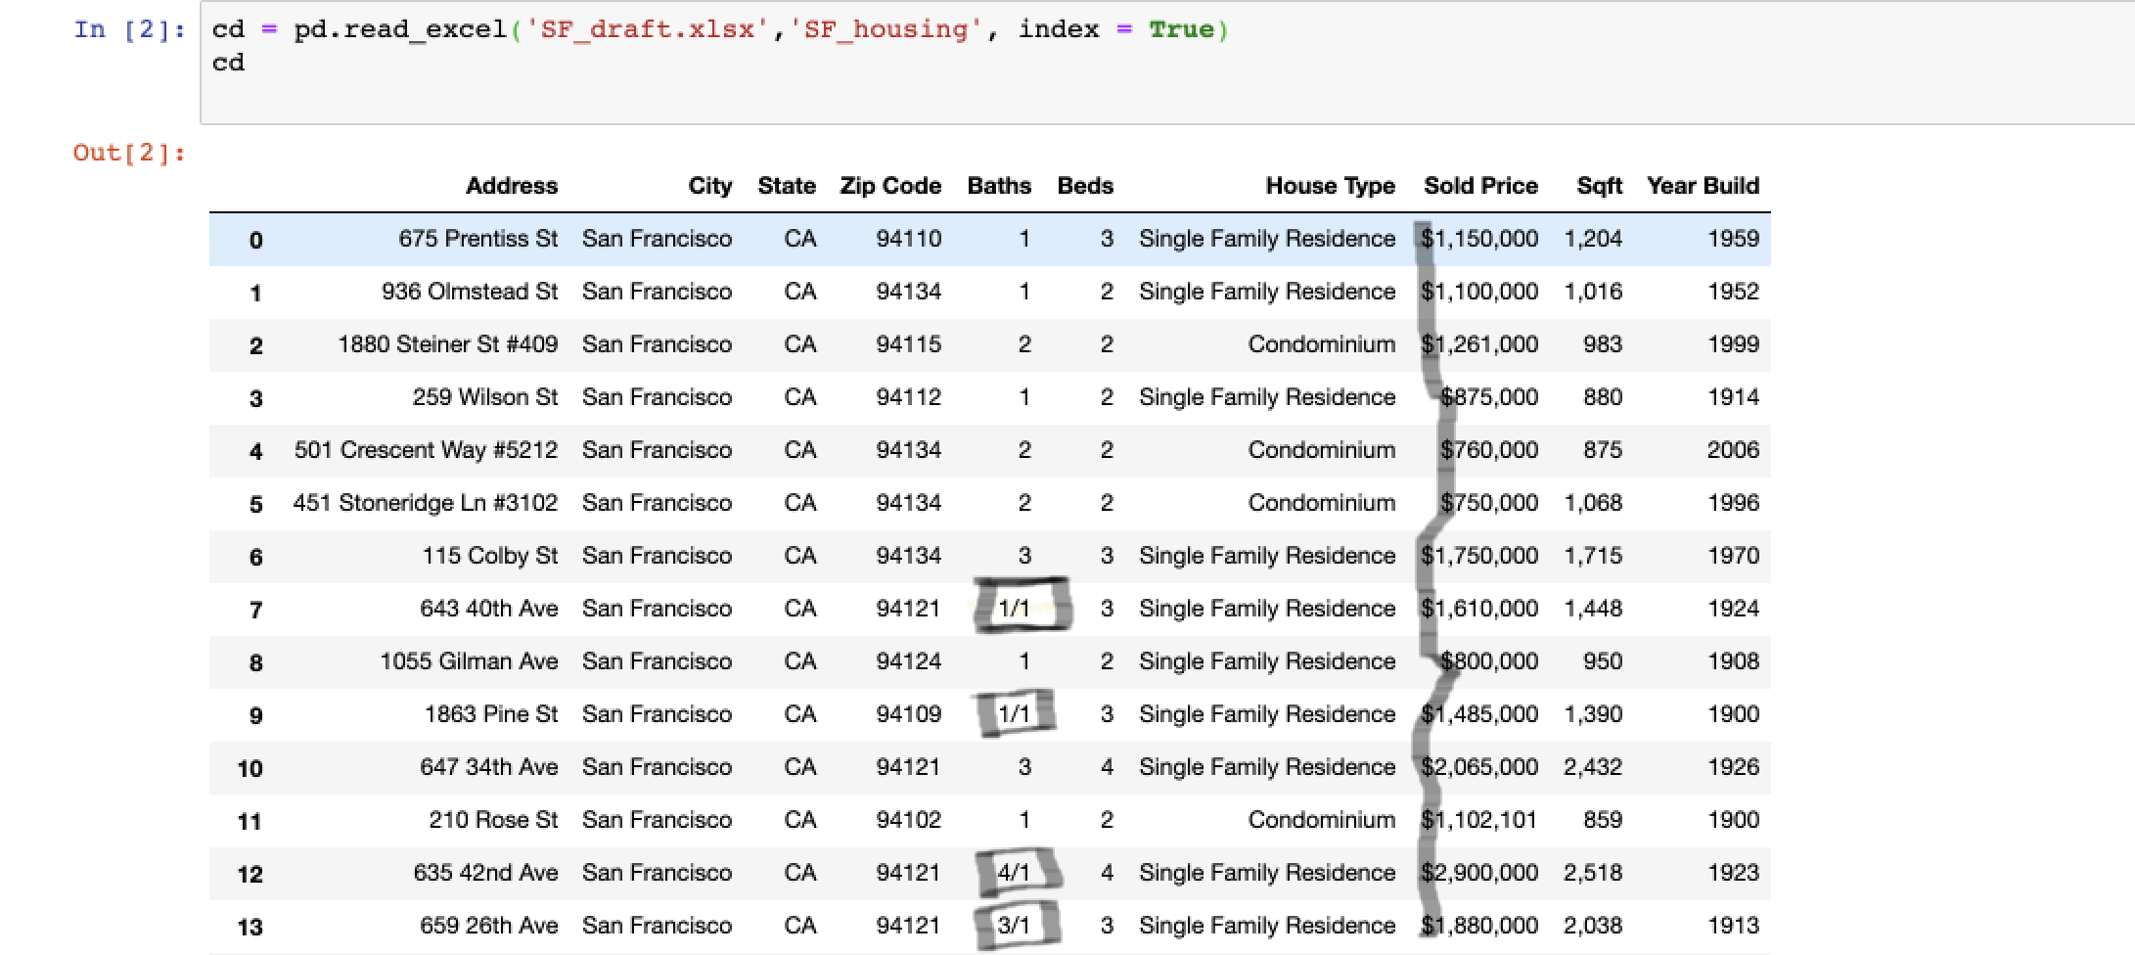
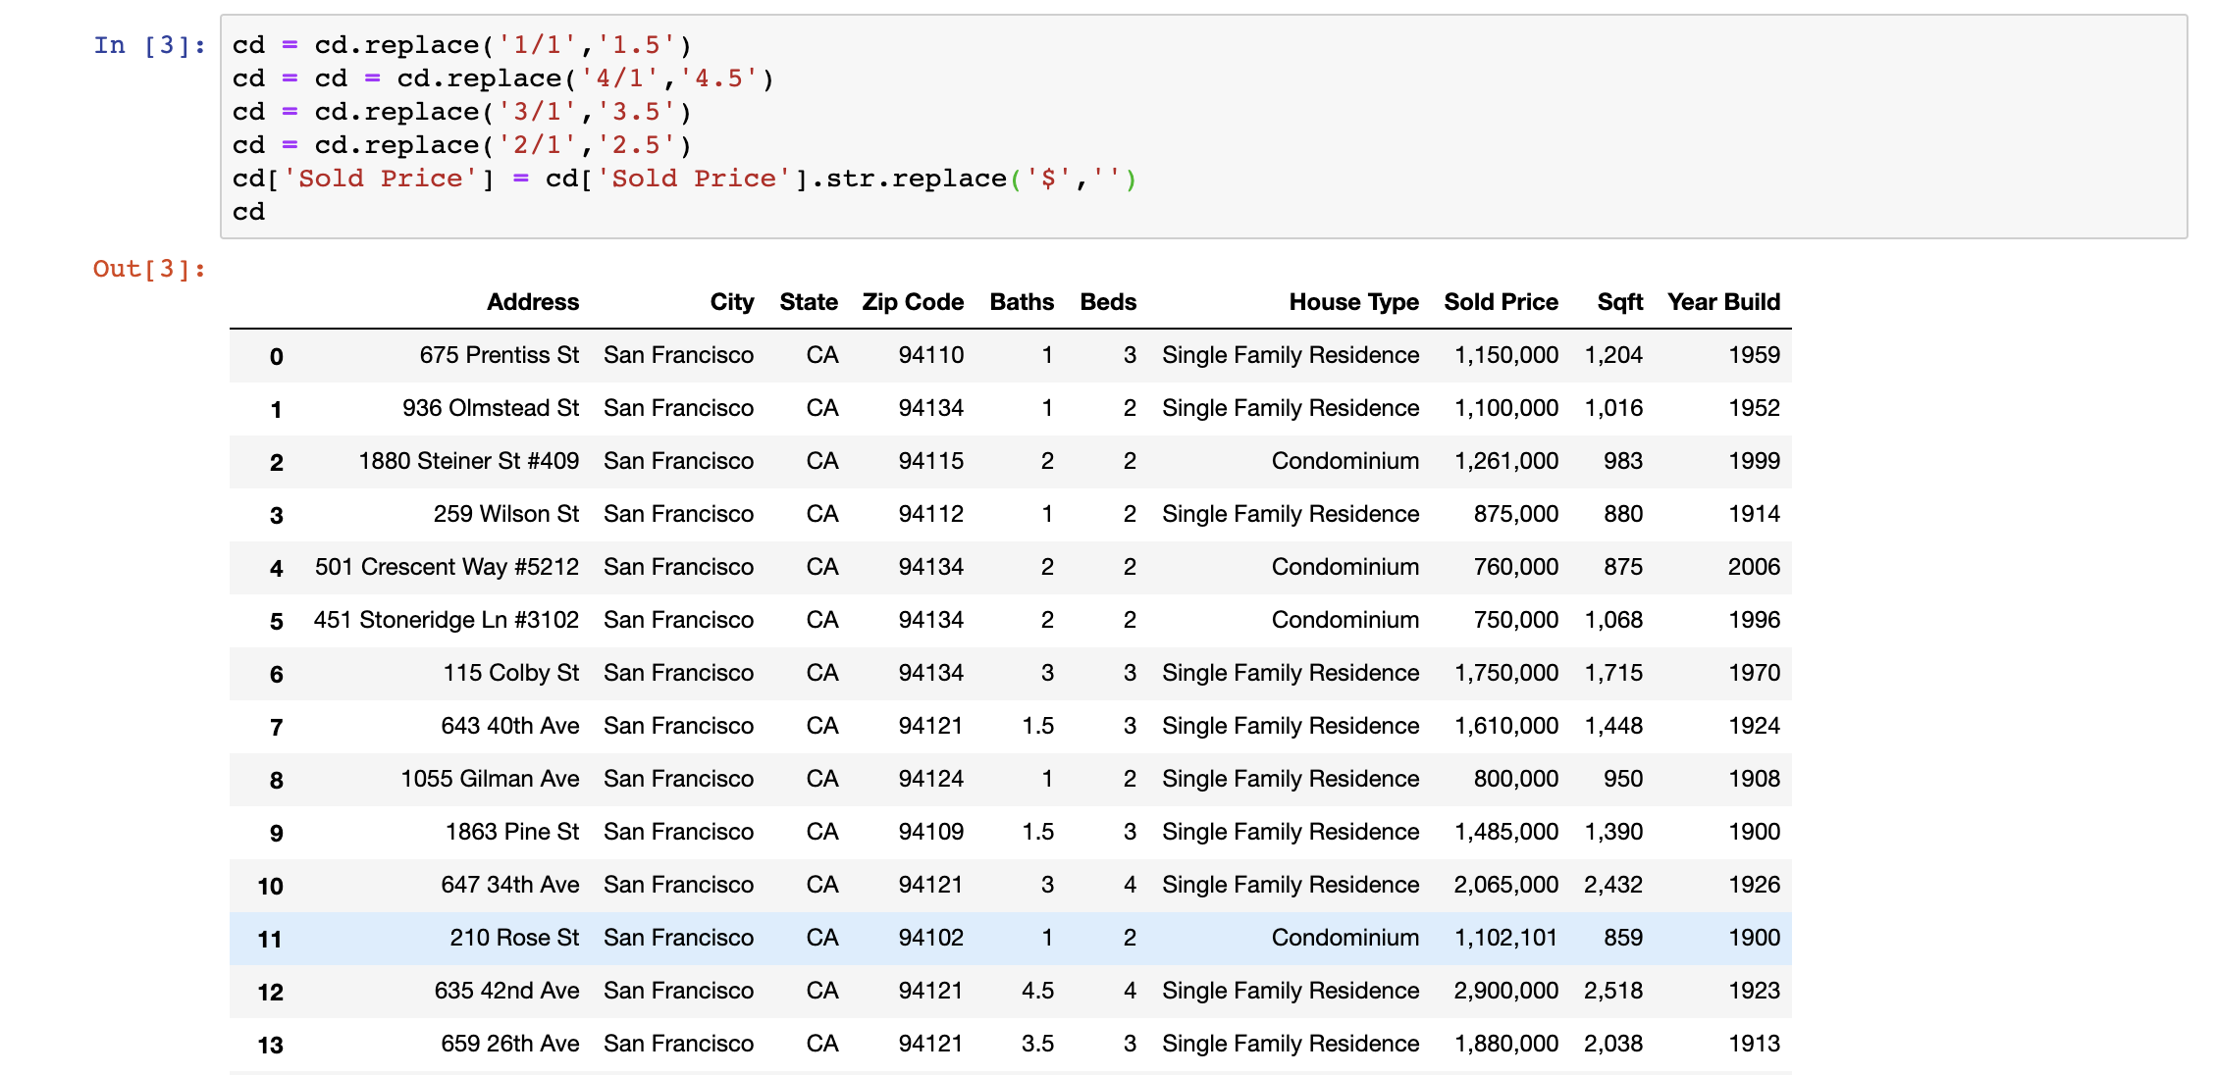
Data Cleaning Techniques
We do not need data like 1/1, 4/1, 3/1, and $ in Baths column and Sold Price
DataFrame.replace() can handle this problem!

Slide 19
Market Insights

Slide 20
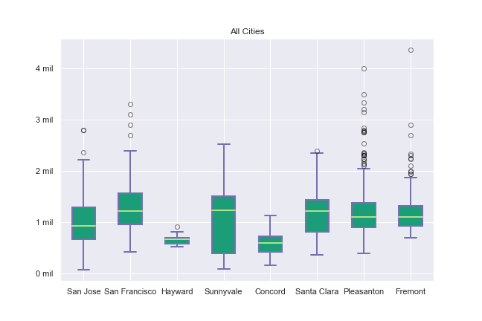
Question: Are visuals enough to predict the housing market?
How do cities compare?
We can see the distribution of houses sold in all cities
Roughly speaking, most houses tend to sell for a million dollars
Outliers in several cities

Slide 21
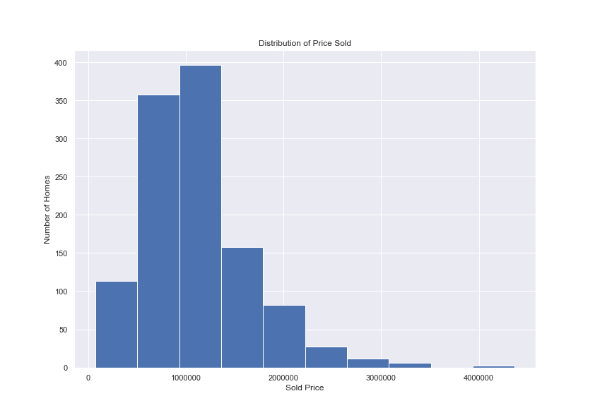
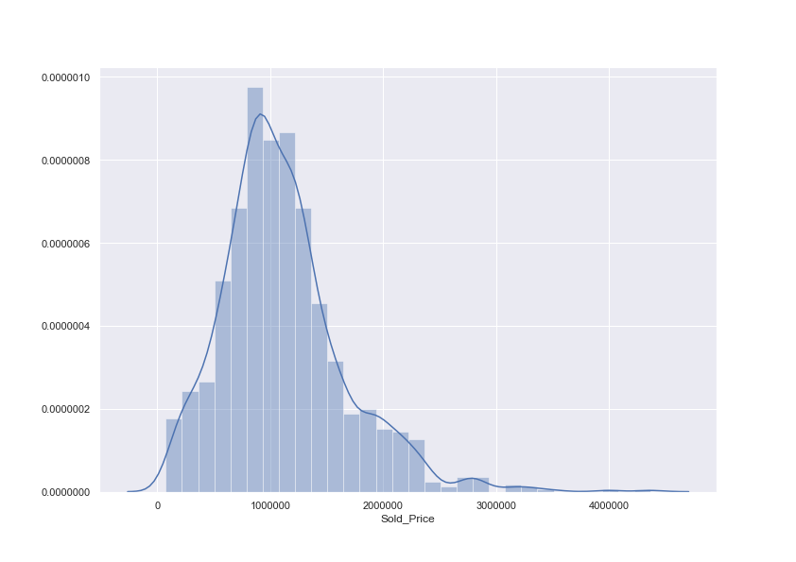
Cities like Pleasanton and Fremont shift the data

Slide 22
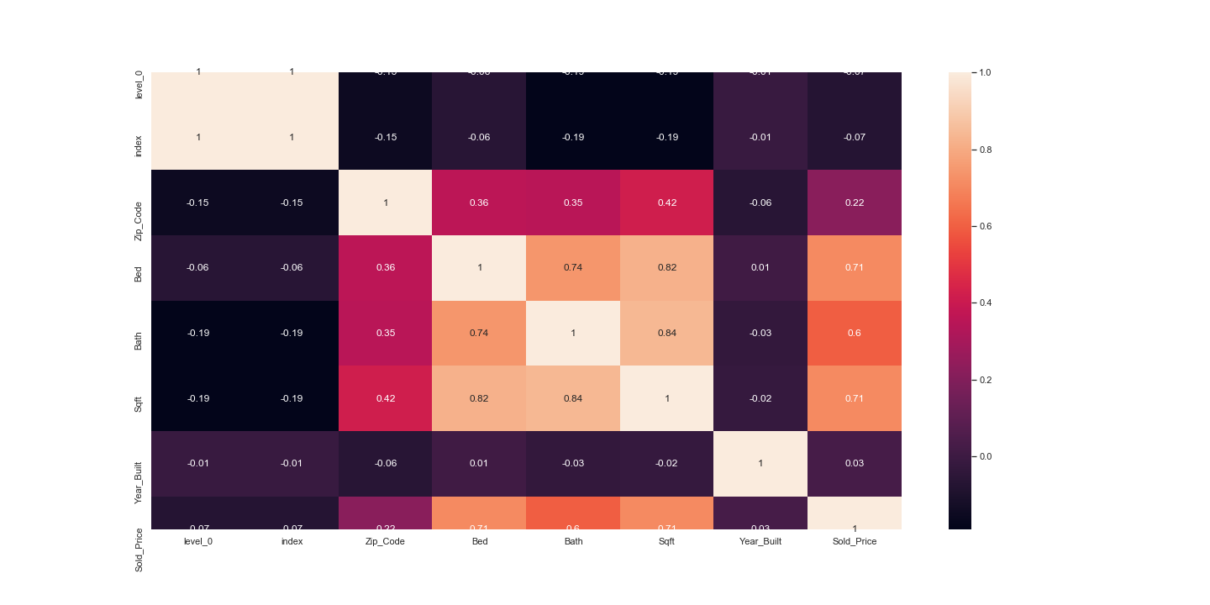
Conclusion: No, further analysis is needed. A regression model can be used to predict the housing market
We can find attributes that are correlated with sold price and add them as variables for a regression model
Bedroom and square feet are possible variables that can be used

Slide 23
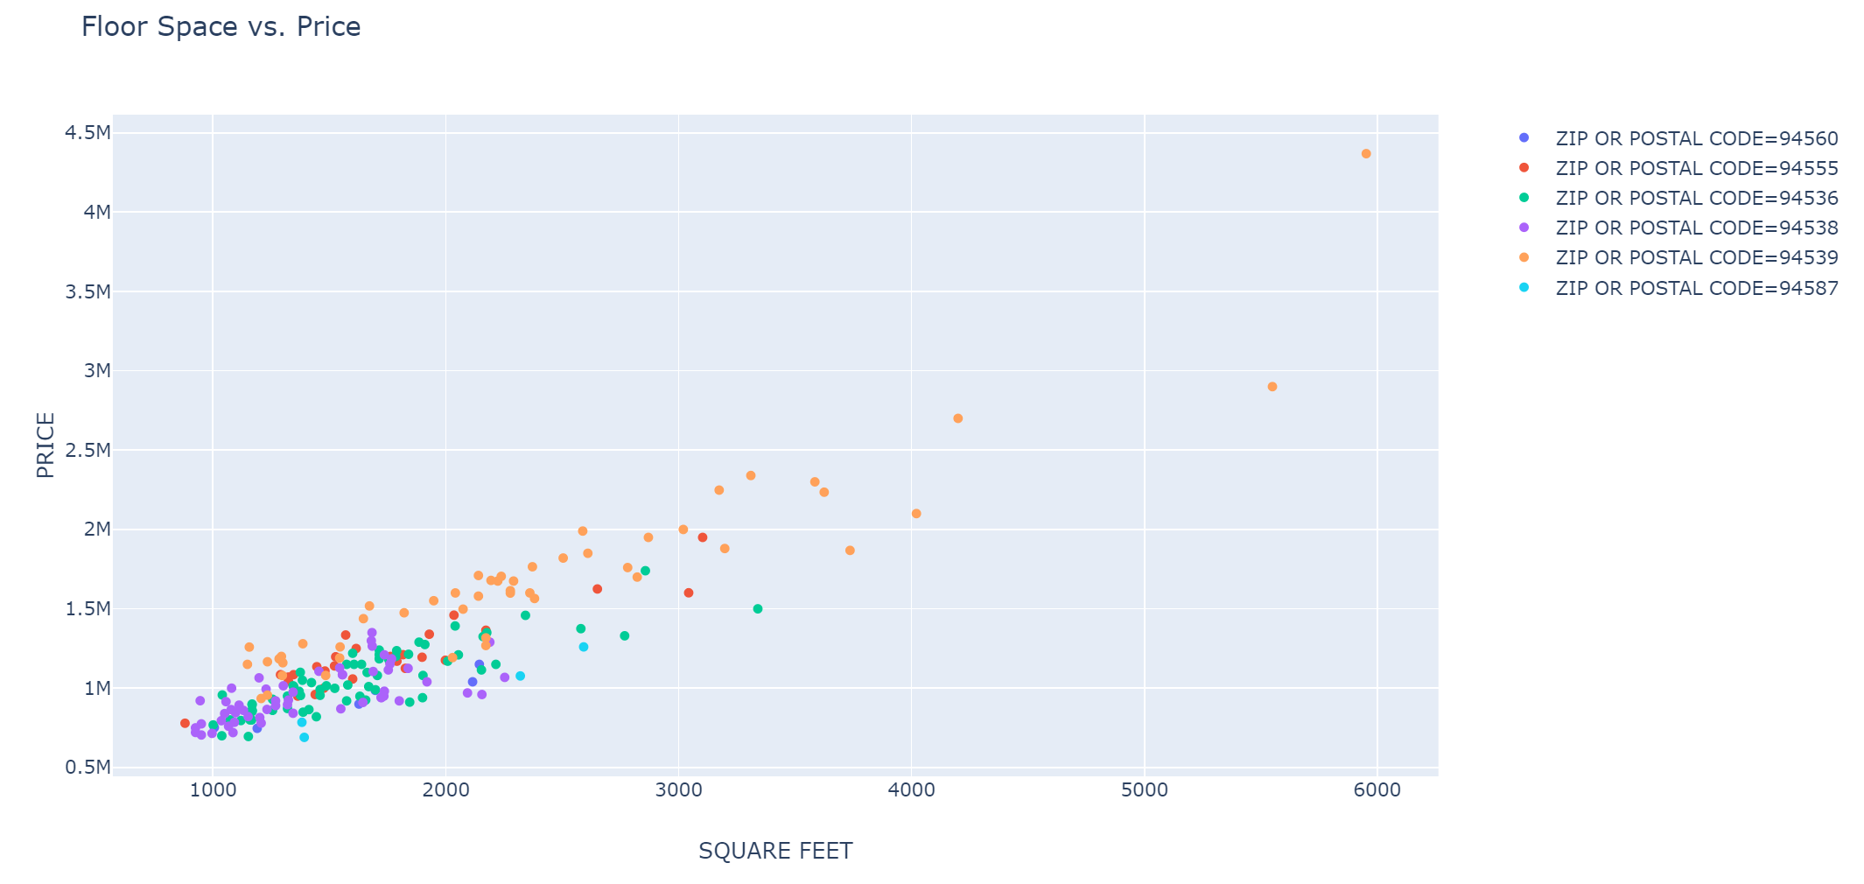
Question: Using Fremont as a sample, can we determine the impact of floor space (sqft) on the price of a home?
Conclusions: Floor space impacts the price of a home but mostly inside a specific location. Prices can vary widely between two locations even in the same city.

Slide 24
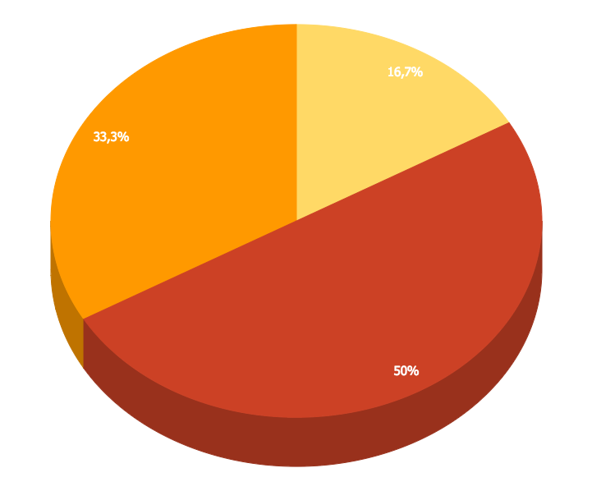
You can insert graphs from Google Sheets

Slide 25
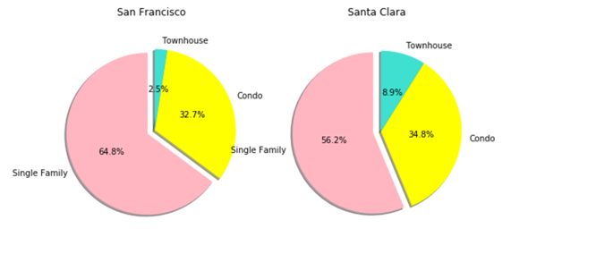
North
(San Francisco)
VS
South
(Santa Clara)
What are their commons and differences between San Francisco and Santa Clara?
▪1. Single family house has the largest portion
▪2. Condo
▪3. Townhouse

Slide 26
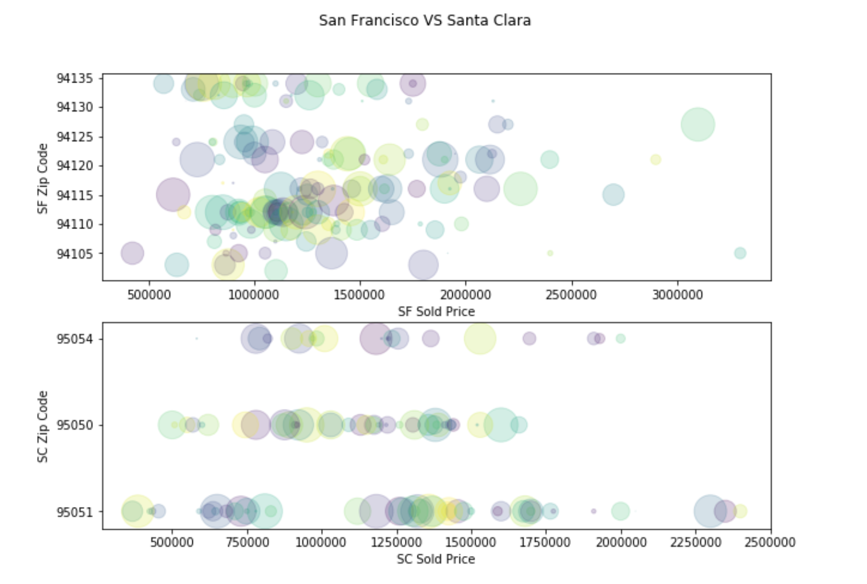
North
(San Francisco)
VS
South
(Santa Clara)
▪San Francisco(decentralize) vs Santa Clara(centralize)
▪Range of regular price: 450K to 2m.
▪San Francisco highest price vs Santa Clara highest price
-(3b3b condo $3.3m VS 4b2b family house $2.4m)
▪San Francisco lowest price vs Santa Clara lowest price
-(2b2b condo $400K VS 1b1b condo $370K)

Slide 27
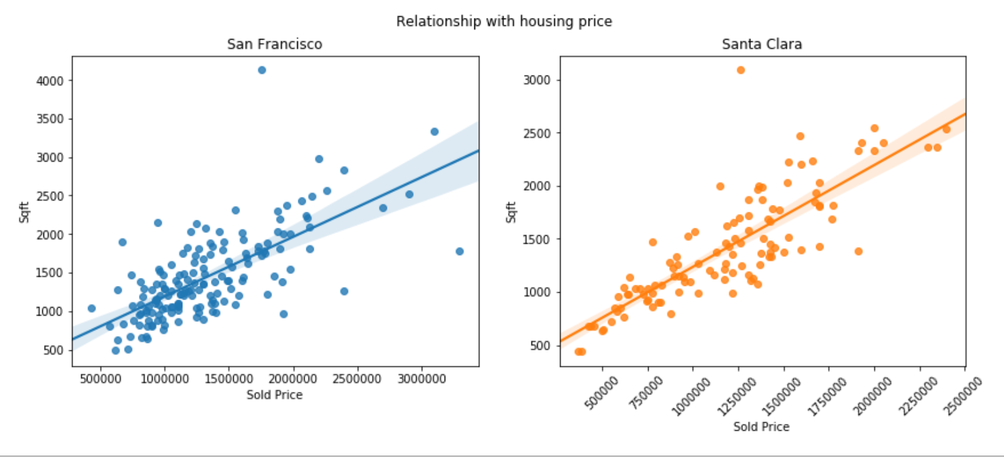
North
(San Francisco)
VS
South
(Santa Clara)
Conclusion:
▪Both the median house cost is about 1 million.
▪They almost have the same range of costs between the lowest and highest prices.
▪ Price is affected by house size.
▪San Francisco's housing price is mostly affected by the view rather than the size.

Slide 28
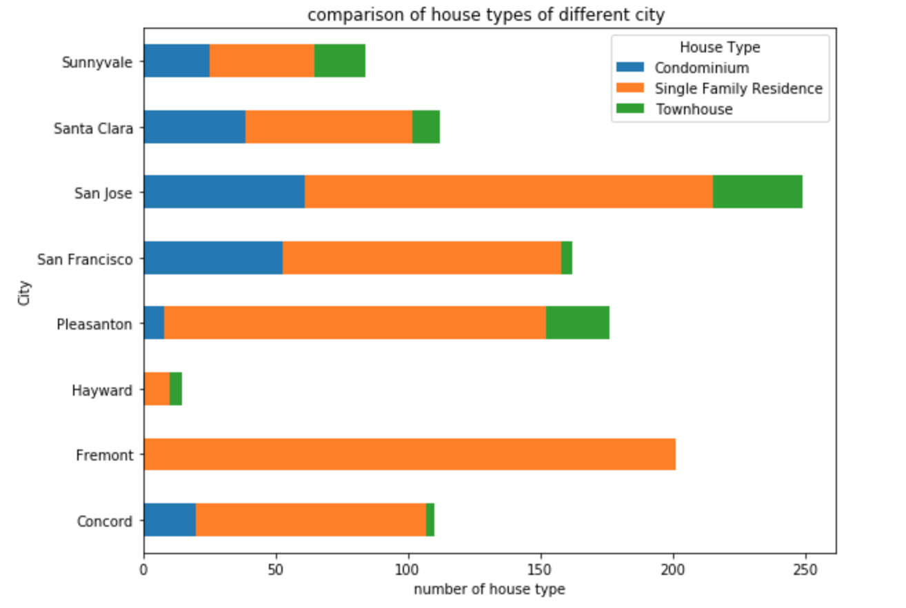
If house types’ distributions are really different from each other among our interested cities.
An overview of house data set scale in each city
Single family is the most common house type
No condominium and townhouse in Fremont of our data set
How can house types give us some information about the house sold price in Bay Area?

Slide 29
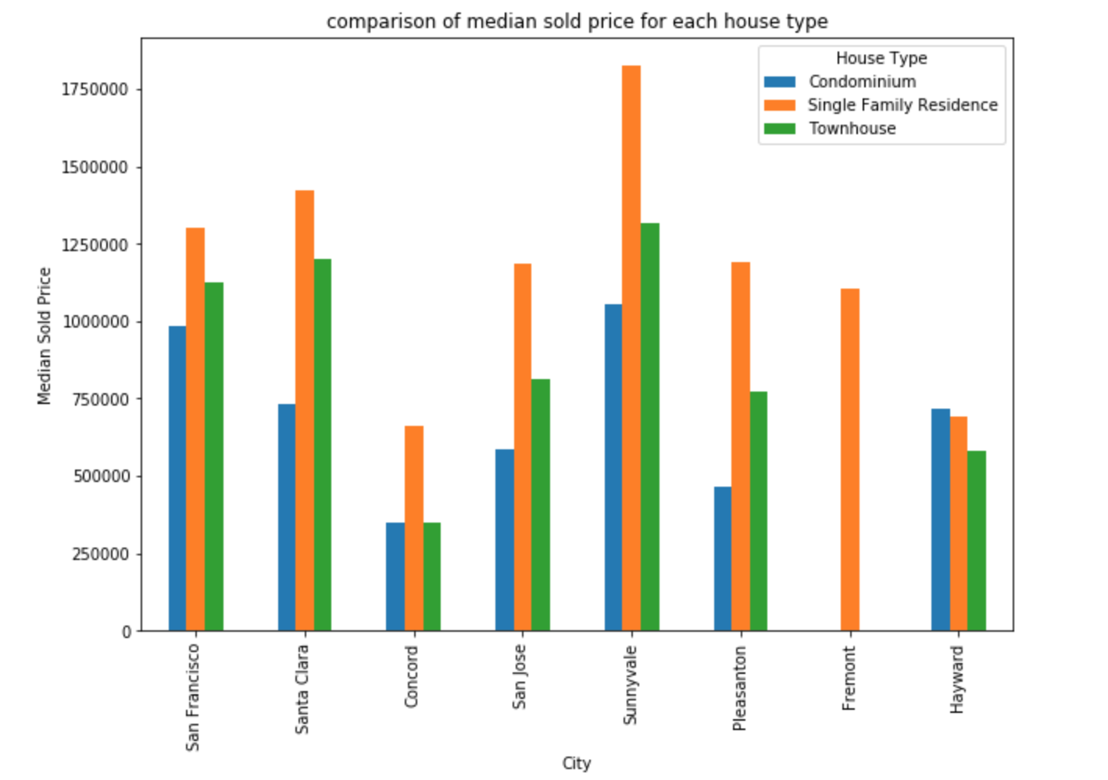
How about each cities’s specific house types and there median sold price?
San francisco, santa clara and sunnyvale seem to have higher sold price, on the other hand, concord and hayward have lower sold price.
Single family house type which represented by the orange color is more expensive than other house types and the condominium’s sold price is the lowest of three house types.
Special thanks to all the people who made and released these awesome resources for free.
Presentation template by SlidesCarnival
Photographs by Unsplash
Learn more about slidedocs at duarte.com/slidedocs

Slide 30
Conclusion
Research question:
How can house types give us some information about the house sold price in Bay Area?
Conclusion:
Single family residence accounts for the largest proportion of house types in Bay Area and roughly has higher median sold price, house sold price for Sunnyvale is greater than other cities.
(please feel free to use this conclusion and may help to edit this conclusion.)

Slide 31
You can also split your content
Try to communicate ideas visually using graphs, icons, illustrations, photos… any resource that helps you convey your message at a glance.
White
Is the color of milk and fresh snow, the color produced by the combination of all the colors of the visible spectrum.
Black
Is the color of coal, ebony, and of outer space. It is the darkest color, the result of the absence of or complete absorption of light.

Slide 32
In two or three columns
Yellow
Is the color of gold, butter and ripe lemons. In the spectrum of visible light, yellow is found between green and orange.
According to surveys in Europe, Canada, and the United States, yellow is the color people most often associate with amusement, gentleness, and spontaneity, but also with duplicity, envy, jealousy, avarice, and, in the U.S., with cowardice.
It plays an important role in Asian culture, particularly in China, where it is seen as the color of happiness, glory, wisdom, harmony, and culture.
Blue
Is the colour of the clear sky and the deep sea. It is located between violet and green on the optical spectrum.
Surveys in the US and Europe show that blue is the colour most commonly associated with harmony, faithfulness, confidence, distance, infinity, the imagination, cold, and sometimes with sadness.
In US and European public opinion polls it is the most popular colour, chosen by almost half of both men and women as their favourite colour.
Red
Is the color of blood, and because of this it has historically been associated with sacrifice, danger and courage.
Modern surveys in the United States and Europe show red is also the color most commonly associated with heat, activity, passion, sexuality, anger, love and joy. Red is also a color widely used for getting attention, such as stop signs or royal dresses.
In China, India and many other Asian countries it is the color of symbolizing happiness and good fortune.

Slide 33

A picture is worth a thousand words
A complex idea can be conveyed with just a single still image, namely making it possible to absorb large amounts of data quickly.

Slide 34
Use charts to explain your ideas
Item 1
Item 2
THE
CONCEPT
Item 3
Item 4

Slide 35
Maps
our office
The word "map" comes from the medieval Latin Mappa mundi, wherein mappa meant napkin or cloth and mundi the world.

Slide 36
Let’s review some concepts
Yellow
Is the color of gold, butter and ripe lemons. In the spectrum of visible light, yellow is found between green and orange.
Blue
Is the colour of the clear sky and the deep sea. It is located between violet and green on the optical spectrum.
Red
Is the color of blood, and because of this it has historically been associated with sacrifice, danger and courage.
Yellow
Is the color of gold, butter and ripe lemons. In the spectrum of visible light, yellow is found between green and orange.
Blue
Is the colour of the clear sky and the deep sea. It is located between violet and green on the optical spectrum.
Red
Is the color of blood, and because of this it has historically been associated with sacrifice, danger and courage.

Slide 37
Android Project
Place your screenshot here
Show and explain your web, app or software projects using these gadget templates.

Slide 38
iPhone Project
Place your screenshot here
Show and explain your web, app or software projects using these gadget templates.

Slide 39
Tablet
Project
Place your screenshot here
Show and explain your web, app or software projects using these gadget templates.

Slide 40
Desktop Project
Place your screenshot here
Show and explain your web, app or software projects using these gadget templates.

Slide 41
Thank you very much for your time
If you have any questions about this document please don’t hesitate to contact us at:
www.ourwebsite.com
hello@mail.me
@companyname

Slide 42
Presentation design
This presentation uses the following typographies and colors:
Titles: Nunito sans
Body copy: Nunito sans
Italic copy: Georgia (system font)
You can download the font on this page:
https://fontlibrary.org/en/font/nunito-sans
Orange #f67031
Yellow #ffa400
Fucsia #ed0036
You don’t need to keep this slide in your presentation. It’s only here to serve you as a design guide if you need to create new slides or download the fonts to edit the presentation in PowerPoint®

Slide 43
This is a slide title
SlideDocs are for distribution; they’re not optimized for presenting. Slides have too much text and font size is too small for an audience to read it projected in a screen.
These documents are useful for:
Distribute before a meeting when the topic is highly complex or technical
To fully explain your idea before booking a meeting with someone
As a reference and follow-up material
Distribute
Explain
Follow-up

Slide 44
Instructions for use
EDIT IN GOOGLE SLIDES
Click on the button under the presentation preview that says "Use as Google Slides Theme".
You will get a copy of this document on your Google Drive and will be able to edit, add or delete slides.
You have to be signed in to your Google account.
EDIT IN POWERPOINT®
Click on the button under the presentation preview that says "Download as PowerPoint template". You will get a .pptx file that you can edit in PowerPoint.
Remember to download and install the fonts used in this presentation (you’ll find the links to the font files needed in the Presentation design slide)
More info on how to use this template at www.slidescarnival.com/help-use-presentation-template
This template is free to use under Creative Commons Attribution license. You can keep the Credits slide or mention SlidesCarnival and other resources used in a slide footer.

Slide 45
This template is for a SlideDoc
A slidedoc is a visual document, developed in presentation software, that is intended to be read and referenced instead of projected.
Slidedocs help you spread your smart thinking by combining visual communications with short chunks of written copy. Their scannable nature makes them great pre-read, reference, and leave-behind materials. Their modularity makes it easy for people to incorporate your ideas into their own communications. And these features together make slidedocs the perfect companion to both written documents and presentations.
Text from duarte.com/slidedocs

Slide 46
Web Scraping
As a communication tool, a table allows a form of generalization of information from an unlimited number of different social or scientific contexts. It provides a familiar way to convey information that might otherwise not be obvious or readily understood.
 | A | B | C
Yellow | 10 | 20 | 7
Blue | 30 | 15 | 10
Orange | 5 | 24 | 16

Slide 47
SlidesCarnival icons are editable shapes.
This means that you can:
Resize them without losing quality.
Change line color, width and style.
Isn’t that nice? :)
Examples:

Slide 48
😉
Now you can use any emoji as an icon!
And of course it resizes without losing quality and you can change the color.
How? Follow Google instructions https://twitter.com/googledocs/status/730087240156643328
✋👆👉👍👤👦👧👨👩👪💃🏃💑❤😂😉😋😒😭👶😸🐟🍒🍔💣📌📖🔨🎃🎈🎨🏈🏰🌏🔌🔑 and many more...

